Slide 1
Elasticity Of Demand :Types Of Elasticity
Name :V Vasanth Reddy
Roll No :23H51A05HJ

Slide 2
Introduction to Elasticity of Demand
Elasticity of demand measures how quantity demanded responds to changes in price.
It helps businesses and policymakers understand consumer behavior and market dynamics.
There are various types of elasticity that indicate different consumer responsiveness.
Notes:
Image source: https://www.slidemake.com

Slide 3
Price Elasticity of Demand
Price elasticity of demand assesses how much the quantity demanded of a good changes when its price changes.
A product is considered elastic if a price change leads to a substantial change in quantity demanded.
Conversely, if demand changes little with price changes, it is termed inelastic.
Notes:
Image source: https://www.slidemake.com

Slide 4
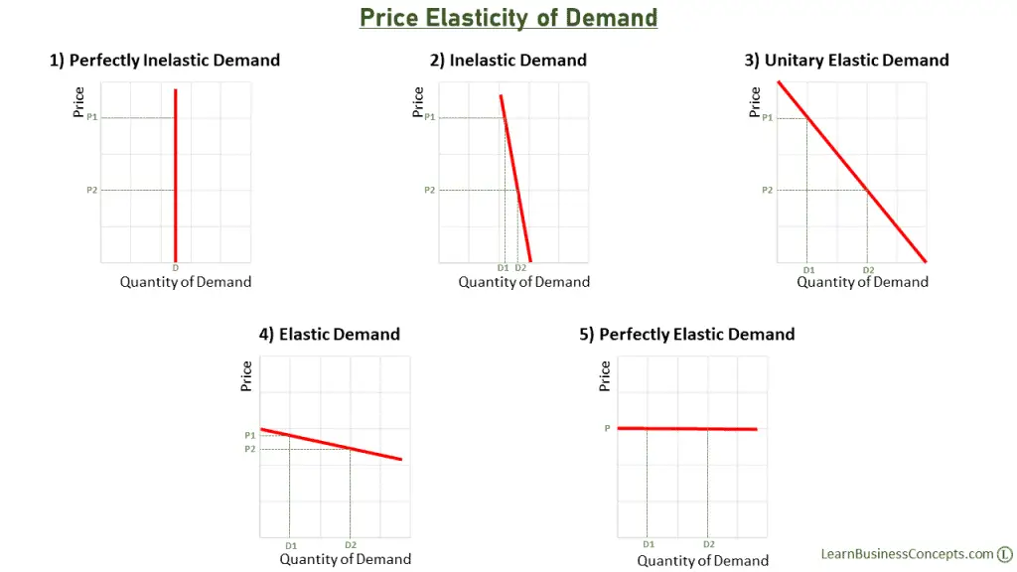
Types of Elasticity
Price elasticity can be classified into elastic, inelastic, and unitary elasticity.
Elastic demand has a coefficient greater than 1, indicating high sensitivity to price changes.
Inelastic demand has a coefficient less than 1, showing low sensitivity to price changes.
Notes:
Image source: https://learnbusinessconcepts.com

Slide 5
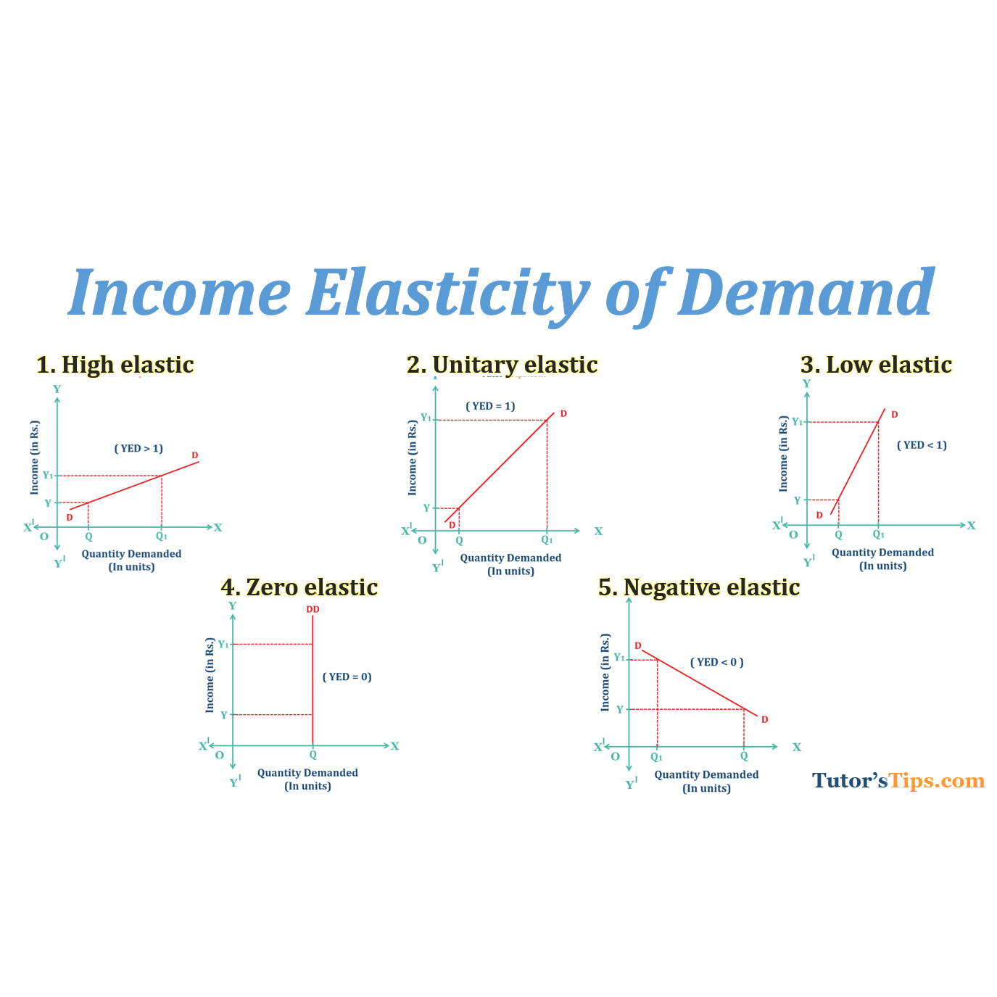
Income Elasticity of Demand
Income elasticity of demand measures how the quantity demanded changes as consumer income changes.
A positive income elasticity indicates that demand increases as income rises, typical for normal goods.
A negative income elasticity suggests that demand decreases as income rises, characteristic of inferior goods.
Notes:
Image source: https://tutorstips.com

Slide 6
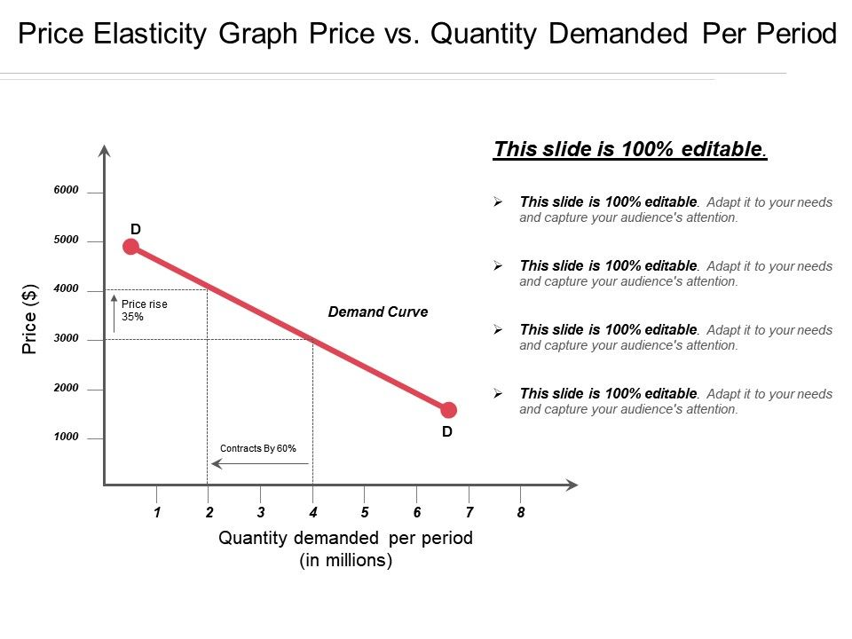
Cross-Price Elasticity of Demand
Cross-price elasticity assesses how the quantity demanded of one good changes in response to the price change of another good.
A positive cross-price elasticity indicates that the goods are substitutes, meaning demand for one increases with the price of the other.
A negative cross-price elasticity suggests that the goods are complements, where demand for one decreases when the price of the other increases.
Notes:
Image source: https://www.slideteam.net

Slide 7
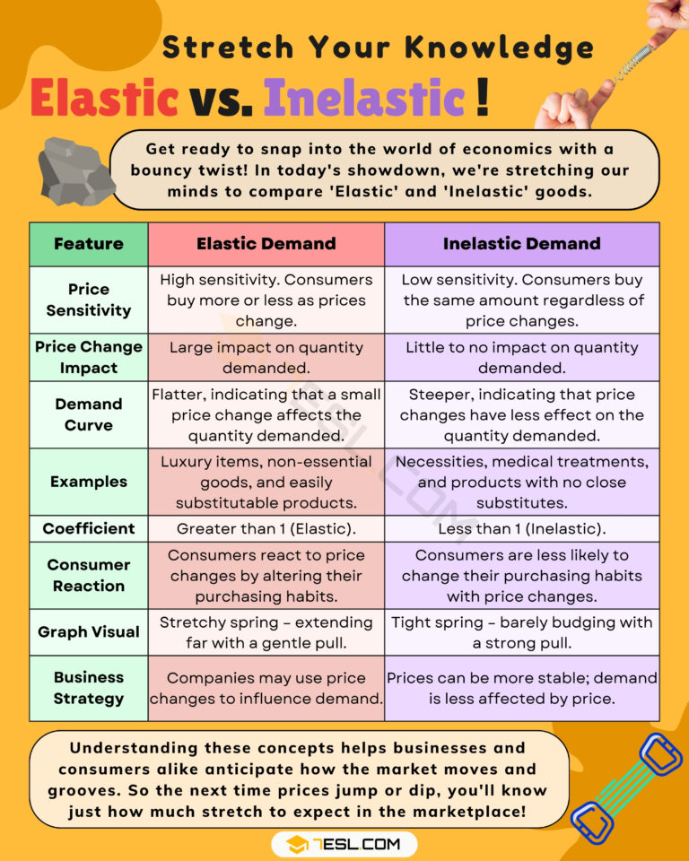
Perfectly Elastic vs. Perfectly Inelastic Demand
Perfectly elastic demand implies that any price increase leads to zero quantity demanded.
Perfectly inelastic demand means that quantity demanded remains constant regardless of price changes.
These extremes are theoretical concepts, used to illustrate the range of consumer responsiveness.
Notes:
Image source: https://7esl.com

Slide 8
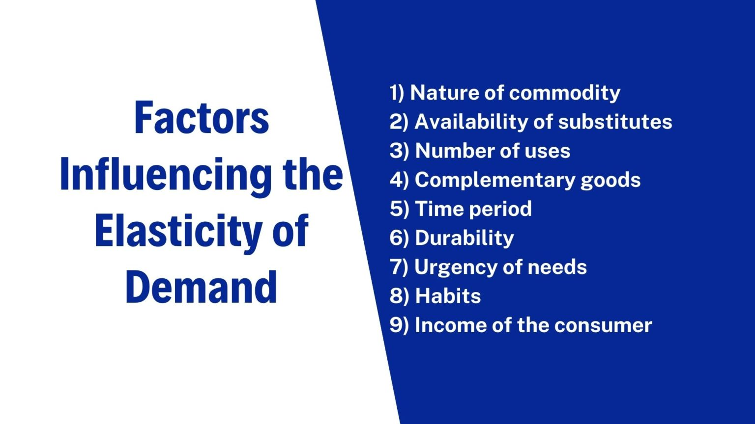
Factors Influencing Elasticity of Demand
Several factors affect the elasticity of demand, including the availability of substitutes and the proportion of income spent on the good.
Necessity goods tend to have inelastic demand, while luxury items are usually more elastic.
Time horizon also plays a role; demand can become more elastic over the long term as consumers adjust their behavior.
Notes:
Image source: https://scholarsclasses.com

Slide 9
Conclusion
Understanding the types of elasticity is crucial for effective pricing strategies and revenue forecasting.
Businesses can tailor their marketing efforts based on elasticity insights to maximize sales.
Notes:
Image source: https://www.coursehero.com

Slide 10
THANK
YOU

